Slide 1
Sec:2.1
The Bisection Method

Slide 2
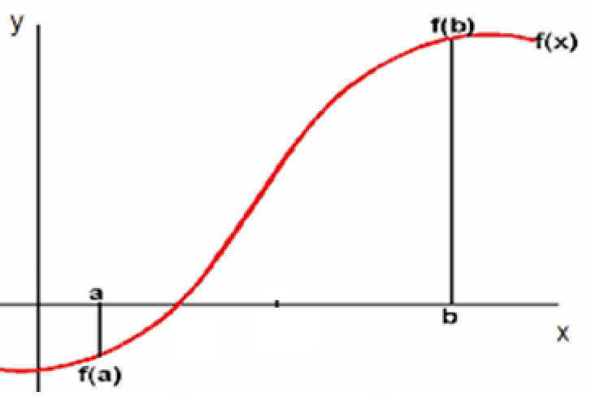
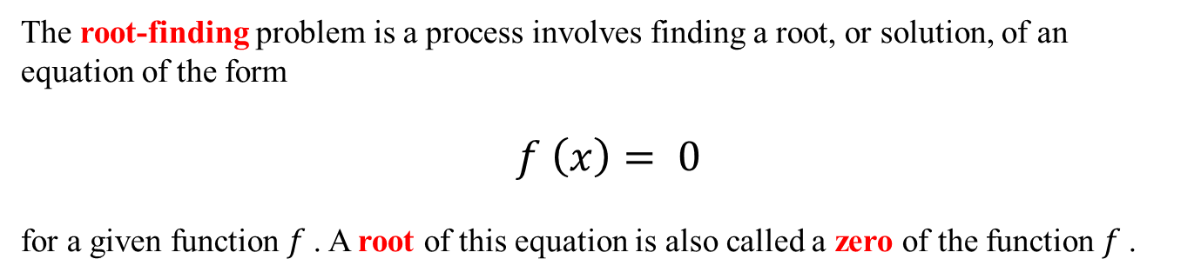
Sec:2.1 The Bisection Method
The root-finding problem is a process involves finding a root, or solution, of an equation of the form
$f \left(x\right)= 0$
for a given function $f$. A root of this equation is also called a zero of the function $f$.
In graph, the root (or zero) of a function is the x-intercept
three numerical methods for
root-finding
root
Sec(2.1): The Bisection Method
Sec(2.2): Fixed point iterations
Sec(2.3): The Newton-Raphson
Method

Slide 3
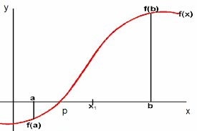


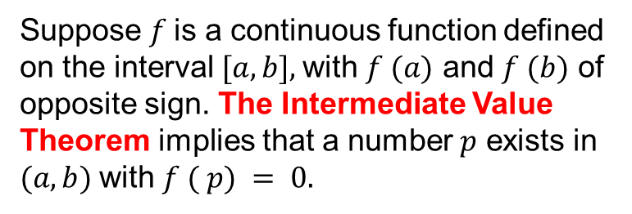


Sec:2.1 The Bisection Method
This technique is based on the Intermediate Value Theorem
Example:
Suppose $f$is a continuous function defined on the interval $[a, b],$with $f (a)$ and $f (b)$ of opposite sign. The Intermediate Value Theorem implies that a number $p$ exists in $(a, b)$with $f ( p) = 0.$
Show that
$$f (x) = \frac{10x^{6}−149x^{5}+10x−149}{10(x^{4}+1)}$$
has a root in [12, 16]
Sol:
12
16
$$f(12)=−34.8$$
$$f(16)=17.6$$

Slide 4






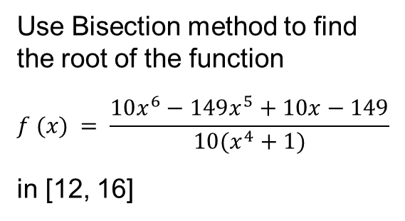





Sec:2.1 The Bisection Method
Example:
Use Bisection method to find the root of the function
$$f (x) = \frac{10x^{6}−149x^{5}+10x−149}{10(x^{4}+1)}$$
in [12, 16]
12
Change of sign
16
-34.8
17.6
$$p_{1}$$
$$=$$
True root: $x_{r}^{∗}=14.9$
12
14
Change of sign
16
$$n$$
$$p_{n}$$
-34.8
-12.6
17.6
1 14.0000000000
2 15.0000000000
3 14.5000000000
4 14.7500000000
5 14.8750000000
6 14.9375000000
7 14.9062500000
8 14.8906250000
9 14.8984375000
10 14.9023437500
11 14.9003906250
12 14.8994140625
13 14.8999023438
14 14.9001464844
15 14.9000244141
16 14.8999633789
$$p_{2}$$
$$=$$
14
15
16
Change of sign
-12.6
1.5
17.6
$$p_{3}$$
$$=$$
Change of sign
14
14.5
15
-12.6
-5.8
1.5

Slide 5















Sec:2.1 The Bisection Method
Textbook notations
$${a=a}_{1}^{}$$
$${b=b}_{1}^{}$$
12
Change of sign
16
Iter1
At the n-th iteration:
-34.8
$$p_{1}$$
17.6
endpoints of the inteval
$$a_{2}^{}$$
$$b_{2}^{}$$
12
14
Change of sign
16
$$[ a_{n}^{}, b_{n}^{}]$$
Iter2
$$p_{2}$$
-34.8
-12.6
17.6
Length of the interval
$$a_{3}^{}$$
$$b_{3}^{}$$
$$b_{n}^{}−a_{n}^{}=$$
14
15
16
Iter3
Change of sign
-12.6
$$p_{3}$$
1.5
17.6
$$L_{n}=\frac{b−a}{2^{n−1}}$$
$$a_{4}^{}$$
$$b_{4}^{}$$
Change of sign
14
14.5
15
Iter4
-12.6
-5.8
1.5
$$p_{4}$$

Slide 6

















Sec:2.1 The Bisection Method
Error Estimates for Bisection
$$a_{1}^{}$$
$$b_{1}^{}$$
12
14
16
Iter1
-34.8
-12.6
17.6
At the iter1:
$$p_{1}$$
$$error=\left|p_{1}−p_{}^{∗}\right|$$
$\left|p_{1}−p_{}^{∗}\right|≤$ $\frac{1}{2}$(length of the interval)
True root live inside this interval
$$p_{}^{∗}$$
$$\left|p_{1}−p_{}^{∗}\right|<\frac{b−a}{2}$$
At the iter2:
$$a_{2}^{}$$
$$b_{2}^{}$$
$\left|p_{2}−p_{}^{∗}\right|≤$ $\frac{1}{2}$(length of the interval)
14
15
16
Iter2
$$\left|p_{2}−p_{}^{∗}\right|≤\frac{b−a}{2^{2}}$$
-12.6
1.5
17.6
$$p_{2}$$
At the nth iteration:
Theorem 2.1
$\left|p_{n}−p_{}^{∗}\right|≤$ $\frac{1}{2}$(length of the interval)
Suppose that f ∈ C[a, b] and f (a) ・f (b) < 0. The Bisection method generates a sequence $\left\{p_{n}\right\}$ approximating a zero p of f with
$$\left|p_{n}−p_{}^{∗}\right|≤\frac{b−a}{2^{n}}$$
the absolute error in the n-th iteration
$$≤\frac{b−a}{2^{n}}$$
$$\left|p_{n}−p_{}^{∗}\right|≤\frac{b−a}{2^{n}}$$

Slide 7








Sec:2.1 The Bisection Method
Theorem 2.1
Example:
Show that
$$f (x) = \frac{10x^{6}−149x^{5}+10x−149}{10(x^{4}+1)}$$
has a root in [12, 16]
Suppose that f ∈ C[a, b] and f (a) ・f (b) < 0. The Bisection method generates a sequence $\left\{p_{n}\right\}$ approximating a zero p of f with
$$\left|p_{n}−p_{}^{∗}\right|≤\frac{b−a}{2^{n}}$$
Remark
$$n$$
$$p_{n}$$
$$\left|p_{n}−p∗\right|$$
It is important to realize that Theorem 2.1 gives only a bound for approximation error and that this bound might be quite conservative. For example,
1 14.0000 9.0000e-01
2 15.0000 1.0000e-01
3 14.5000 4.0000e-01
4 14.7500 1.5000e-01
5 14.8750 2.5000e-02
6 14.9375 3.7500e-02
7 14.9063 6.2500e-03
8 14.8906 9.3750e-03
9 14.8984 1.5625e-03
$$\left|p_{7}−p∗\right|<\frac{16−12}{2^{7}}=3.125e−2$$
$$\left|p_{7}−p∗\right|=6.25e−3$$

Slide 8











Sec:2.1 The Bisection Method
Theorem 2.1
Example:
Suppose that f ∈ C[a, b] and f (a) ・f (b) < 0. The Bisection method generates a sequence $\left\{p_{n}\right\}$ approximating a zero p of f with
Show that
$$f (x) = \frac{10x^{6}−149x^{5}+10x−149}{10(x^{4}+1)}$$
has a root in [12, 16]
$$\left|p_{n}−p_{}^{∗}\right|≤\frac{b−a}{2^{n}}$$
Example
Determine the number of iterations necessary to solve f (x) = 0 with accuracy 10−2 using a1 = 12 and b1 = 16.
$$n$$
$$p_{n}$$
$$\left|p_{n}−p∗\right|$$
1 14.0000 9.0000e-01
2 15.0000 1.0000e-01
3 14.5000 4.0000e-01
4 14.7500 1.5000e-01
5 14.8750 2.5000e-02
6 14.9375 3.7500e-02
7 14.9063 6.2500e-03
8 14.8906 9.3750e-03
9 14.8984 1.5625e-03
10 14.9023 2.3437e-03
11 14.9004 3.9062e-04
12 14.8994 5.8594e-04
$$\left|p_{n}−p∗\right|<\frac{16−12}{2^{n}}$$
$$<{10}^{−2}$$
the desired error
solve for n:
$$2^{n}>\frac{4}{{10}^{−2}}$$
$$n>8.64$$
$$n=9$$
Remark
It is important to keep in mind that the error analysis gives only a bound for the number of iterations. In many cases this bound is much larger than the actual number required.

Slide 9

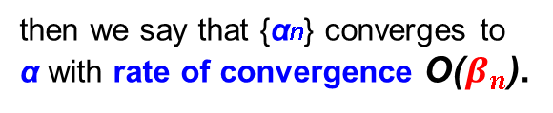


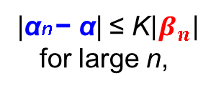


Sec:1.2 The Bisection Method
Theorem 2.1
Rates of Convergence
Suppose that f ∈ C[a, b] and f (a) ・f (b) < 0. The Bisection method generates a sequence $\left\{p_{n}\right\}$ approximating a zero p of f with
sequence:
{αn} → α
{$β_{n}$} → 0
$$\left|p_{n}−p_{}^{∗}\right|≤\frac{b−a}{2^{n}}$$
then we say that {αn} converges to α with rate of convergence O($β_{n}$).
If a positive constant K exists with
$$\left|p_{n}−p_{}^{∗}\right|≤(b−a)\frac{1}{2^{n}}$$
|αn − α| ≤ K$\left|β_{n}\right|$
for large n,
$$\left|p_{n}−p_{}^{∗}\right|≤K\frac{1}{2^{n}}$$
Then we write:
αn = α + O($β_{n}$).
the sequence $\left\{p_{n}\right\}$ converges to p with rate of convergence O($\frac{1}{2^{n}}$).

Slide 10

Sec:2.1 The Bisection Method
%%
clear; clc
a=12; b=16; es=1e-3;
f=@(x) ( x.^5*(10*x-149) + 10*x - 149)./(10*(x^4+1));
%%
max_iter= round((log(b-a)-log(es))/log(2));
fa=f(a); fb=f(b); iter =0;
if fa*fb > 0,return,end
%%
for k=1:max_iter
iter = iter +1;
p=(a+b)/2; fp=f(p); x(k)=p;
if fp==0
a=p; b=p;
elseif sign(fb)*sign(fp)<0
a=p; fa=fp;
else
b=p; fb=fp;
end
fprintf('%d %14.4f %14.4e \n', iter,p,abs(p-14.9));
end
Remark
sign(fb)*sign(fp)<0
instead of
fb*fp<0
avoids the possibility of overflow or underflow in the multiplication

